Slide 1

Meraki API Demo Platform
Shiyue (Shay) Cheng
Solutions Architect
November 2020

Slide 2
Recording of this Presentation
https://cisco.box.com/shared/static/s3n3ggogkye8lo4vvlnhdh90ptoj5nur.mp4
(accessible to Cisco employees)
Selected timestamps:
how to get started @ 3:33
beginning of demo @ 5:25
adding your customers to the demo @ 15:24
crowd density visualization w/ scanning API @ 21:06
setting up webhook alerts on production org @ 31:26
connecting MT sensor to MV snapshot @ 31:50
architecture of solution @ 33:09

Slide 3
Impetus & Motivation
APIs are abstract and difficult to understand
We have historically demoed with:
Developer Hub and Marketplace
Interactive API docs & Postman collection
Code snippets & scripts, static slides/screenshots
We wanted to create:
Super easy demo that anybody can try, run, & experience
No need to show documentation, source code, or even know how APIs work
Present live use cases for configuring, monitoring, reporting, & alerting
Dedicated instance that is customized for each demo/customer
Potentially even on a mobile device for an elevator pitch… assuming you have signal 🤪

Slide 4
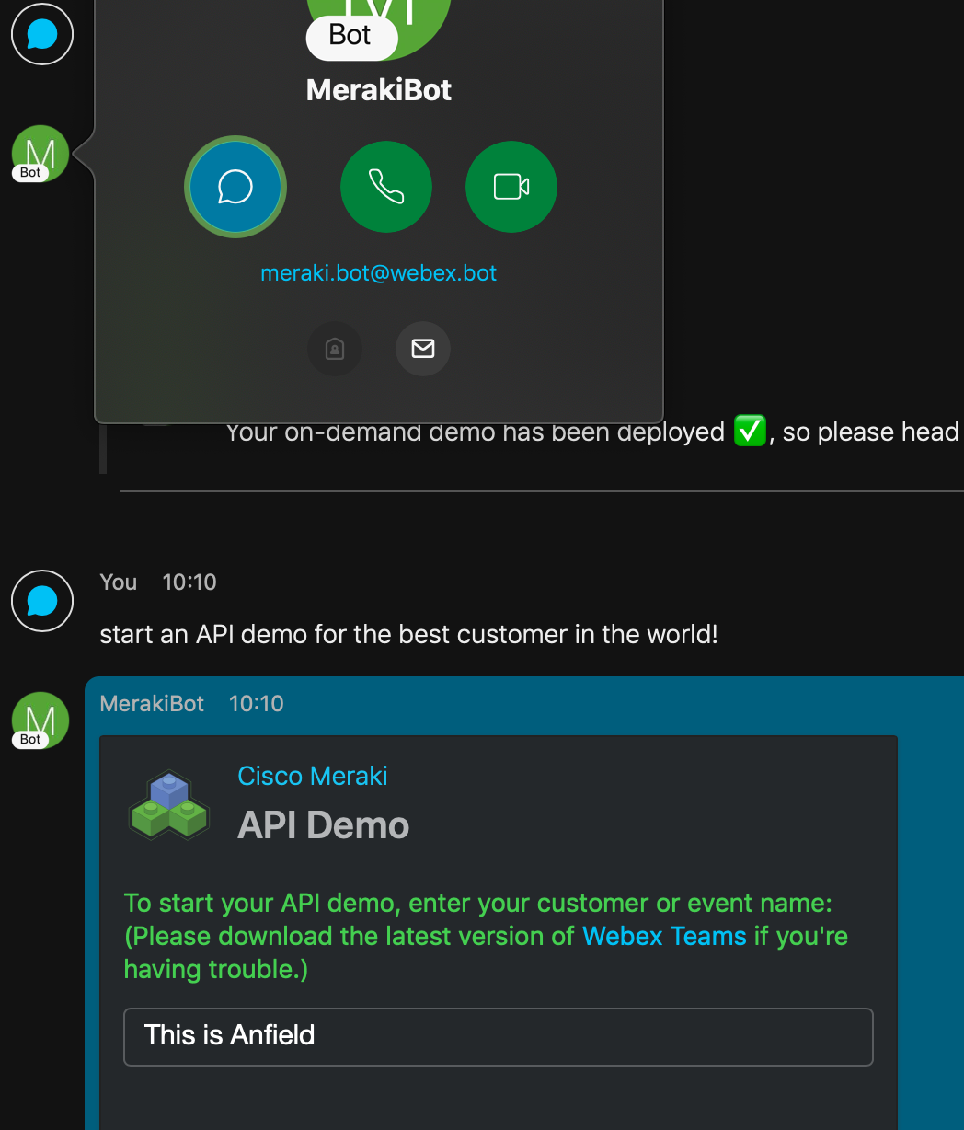
User Guide
Runs on Webex Teams, so free & accessible to anybody
To get started, just ask for an “API demo” with meraki.bot@webex.bot
Follow the instructions on the cards
Enter in your customer or event name (be creative; don’t use “test”)
On-demand instance starts in new Webex Teams room/space
Use your API key to link to an existing dashboard org
Or create a new temporary org from scratch without needing a key

Slide 5
Demo

Slide 6





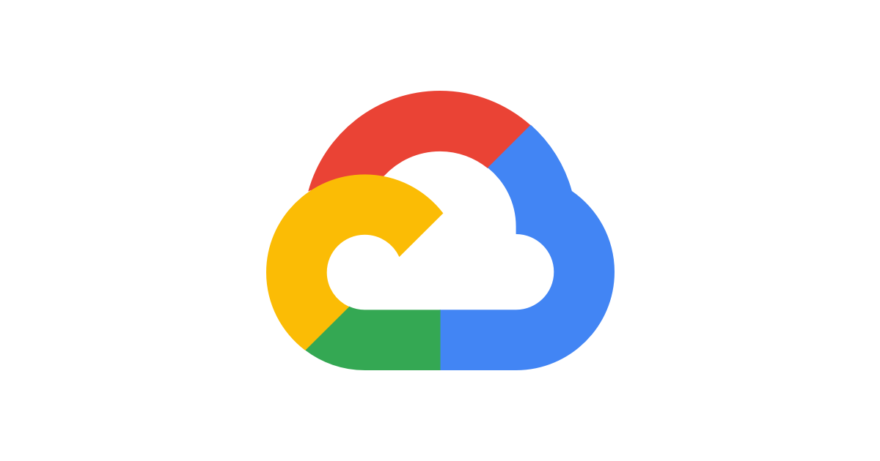


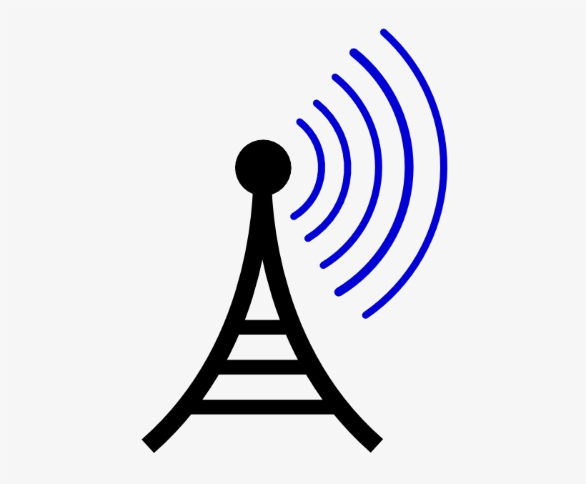



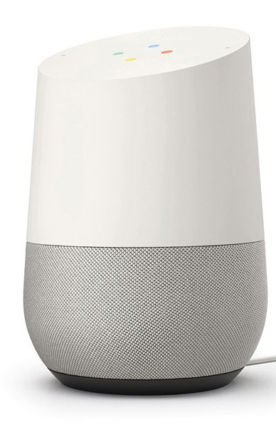
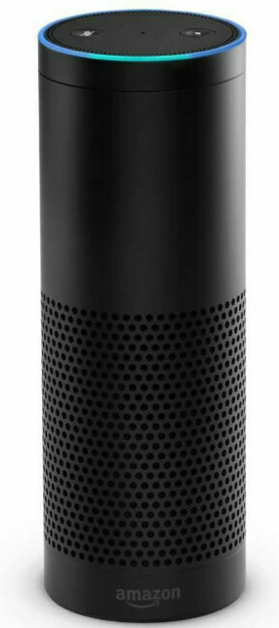









Web App
Google Cloud Platform
Architecture
Cloud Run
App Engine
Firestore
Webex Teams
Google Cloud Functions
Users
Vision API
Plivo (SMS/MMS)
Image Search
Time Zone API
3rd Party
APIs
Wi-Fi Scanning Location API v3
Webhook alerts
Full Stack Network
(MX, MS, MR, MV)
Meraki Dashboard
Notes:
Webex Teams webhook is triggered when bot receives either a message or a card submission from the user
that webhook is processed by a Google Cloud Function (akin to AWS Lambda function), which looks up a database where information like Webex room ID, Meraki dashboard org, and user info is mapped together
this backend database is using GCP’s Firestore (like AWS DynamoDB), which is a NoSQL database that has these documents indexed on the Webex Teams room/space IDs
the Cloud Function has all the logic for responding to button presses (card submissions) and makes calls to the Meraki dashboard API (using our new Python library of course!) to retrieve information, then calls to the Webex API to post cards (to get more inputs) or messages (using new threaded messages functionality when possible)
for Meraki’s dashboard webhooks, there is a second Google Cloud Function that processes those incoming alert POSTs, and using the org ID in the payload finds the corresponding demo instance (Webex Teams room) from the Firestore database
when the user deploys the web app, a container service that has already been added to the project’s Container Registry gets deployed on-demand using Google’s Cloud Run service (like AWS Fargate); this container includes the Python Flask web app code and we initiate it with the unique environmental variables of API key, org ID, and logo URL. Cloud Run is similar to Cloud Functions except that it handles containers and Docker images directly, without the need for us to manage Kubernetes (overkill for this project)
for virtual serials, we have a pool of shared serial numbers, and the demo/user-allocations are also stored in Firestore. when a new org is created with dummy networks containing the virtual devices, an algorithm finds a “slot” that is not currently in use, and then frees it up when the demo is shut down.
when demo shuts down, all users are booted from the room, with a message sent saying who did it (so it’s not mysterious), and the backend services are deprovisioned (web app, virtual serials, dashboard org, etc.)

Slide 7
Design Considerations
Extensive Webex Teams features for frontend UI’s presentation layer
Buttons & cards + threading
Chat, if user prefers
Investigated creating a dedicated bot account per demo
Bot instance would have customized logo for its avatar
But requires screen scraping, not reliable, & takes longer to deploy
GCP Cloud Functions & Cloud Run for application & business logic layer
Kubernetes (GKE), while powerful, is very complicated and overkill for our purpose
Instead, we use separate Cloud Functions to handle incoming Webex Teams & Meraki Dashboard webhooks
These functions are overloaded to map each demo’s unique instance/room to the backend database (data layer), using non-relational Firestore
Cloud Run is FaaS (serverless) with Docker support, perfect for web app’s container
App Engine added later for crowd density visualization

Slide 8
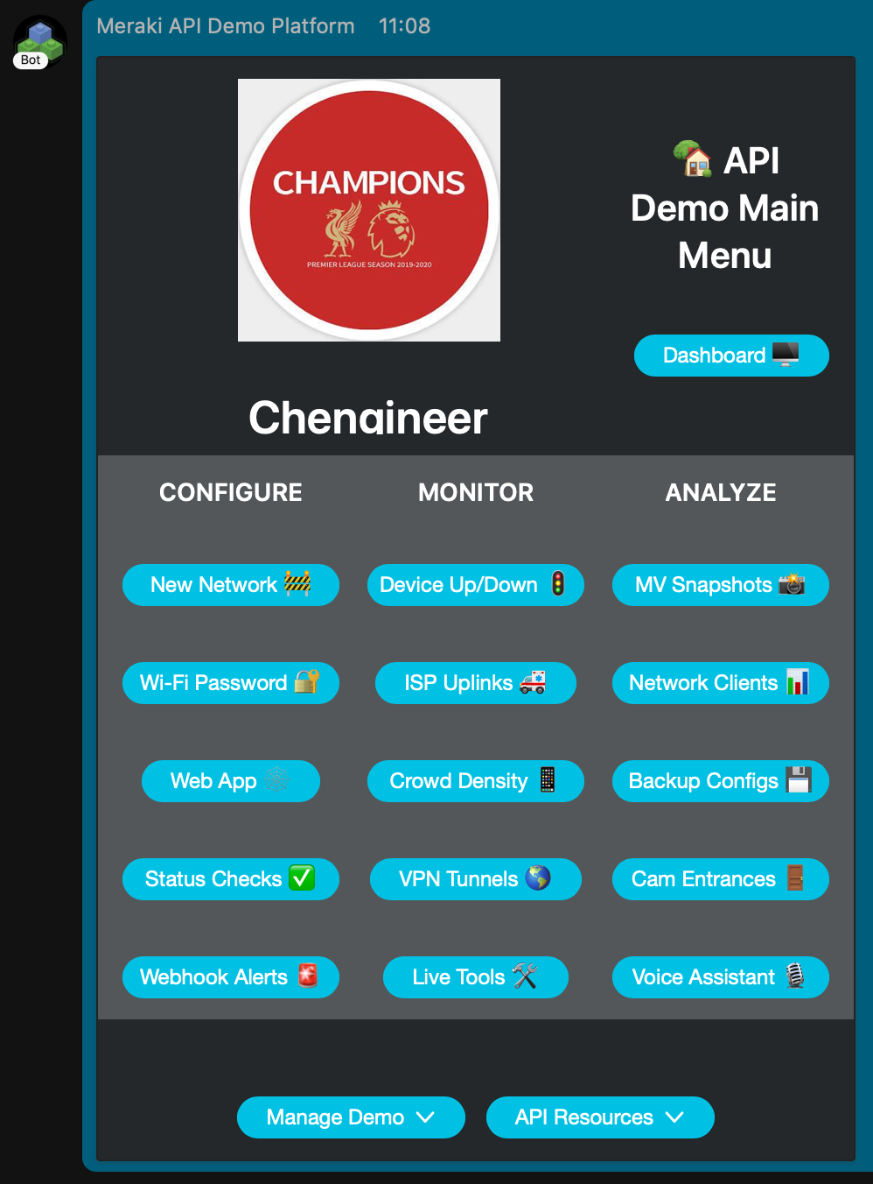
Updates & Metrics
In 8 months since launching in spring 2020:
Winner at FY20 Cisco CodeFest hackathon
Original 2 rows of features (buttons) have now been expanded to 5
New features from September’s fall launch:
Configure webhook alerts 🚨 to receive them in Webex Teams, including new MT sensor triggering MV camera snapshots
Live tools 🛠 to operate devices in networks without requiring full dashboard admin access
Easily interact with Google Assistant/Home + Amazon Alexa/Echo for voice assistant 🎙 integration (MT10 sensor also featured)
License plate 🚘 detection with ecosystem partner app Plate Recognizer
85% of Meraki SEs have run at least one API demo:
As of November 7th, there have been more than 3000 demos conducted in total, with over 22.8K+ user interactions
Usage categorization breaks down to roughly 40% Meraki SEs, 30% other Merakians (Sales, PM, Support), 20% non-Meraki Cisco teammates, & 10% partners + end customers (along with a few competitors)

Slide 9
“The Meraki API Demo Platform makes us sales peeps look smart. [Fortune 10] customer was very impressed!”
Meraki SE
“This platform is the most undervalued selling tool we have within the company.”
Meraki SE Director

Slide 10
Thank you, especially to these friends who offered their time & support to this project:
Larry Woods, Jon Hartman, Daanish Husain, Andrey Salnikov, Lucio D’Andrea, Wesley Yeager, Medi Jaafari, Aaron Dixon, Victor Hernandez Ordonez, Seungro Ron Lee, Jose Rojas Pena, Nico Darrow, Jeffry Handal, Dave Fraser, John Chandler, Brennan Martin, Yuji Terada, Kiara Montalvo Villarreal, Korey Rebello, Kyle Murdock, Mike Lavallee, Paul Reetz, Dave Martin, Derrick Williams, Felix Lam, Paul Hasstedt, Aaron Willette

